Slide 1
Introduction to Cloud Computing

Slide 2
By the end of this section, you will have an understanding of the following:
Cloud- Introduction
AWS-Introduction and domains

Slide 3
Cloud computing
Cloud Computing is defined as accessing, manipulating and configuring the hardware and software resources remotely.
Main advantage of using clouds is that, it is able to offer online data storage, infrastructure, and application.
It also aims at delivering computing power over the internet rather than physically having the computing resources in the customer location.
It is not needed to install a software to access or manipulate cloud application.

Slide 4
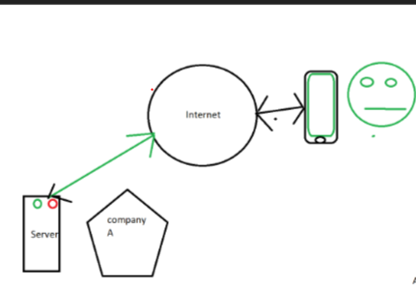
Architecture in the premises
Whenever a company has a server, all its information are
stored there and when anybody wants to access those information, they need to access through internet as shown.

Slide 5
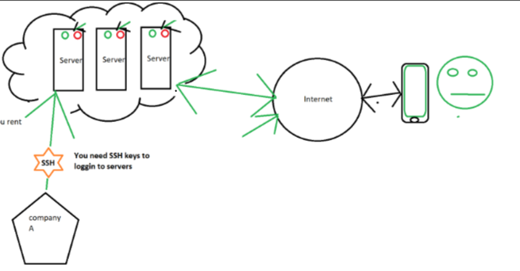
Cloud architecture
When you host your server in the cloud, hosting services will take care of the data you store in the cloud.

Slide 6
Cloud computing-concepts
In order to make cloud computing feasible, there are some models and services running behind the scene.
They are categorised into two:
(1)Deployment models
Basically explains the type of access anyone could establish in the cloud.
(2)Service Models
They are based on the types of services offered by cloud computing.

Slide 7
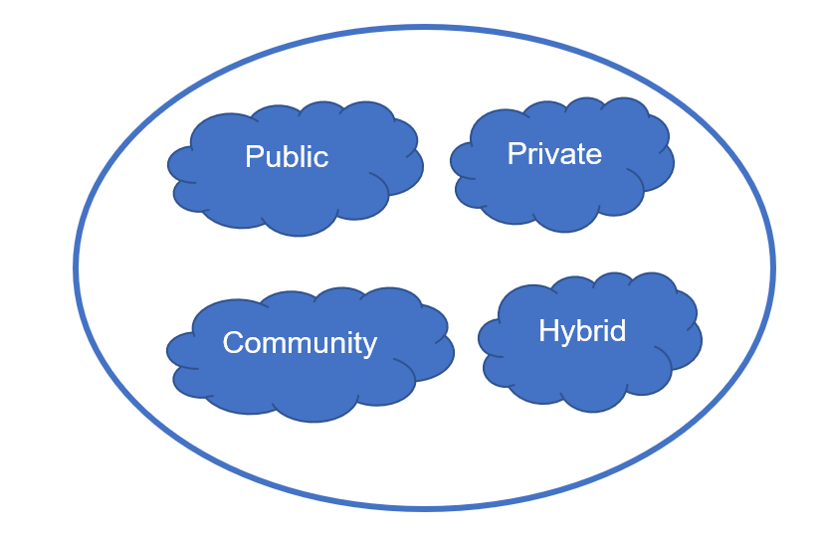
Cloud-Deployment models
Following are the types of deployment models in the cloud which is explained in the next slide:

Slide 8
Cloud-Deployment Models
Cloud can have any of the four types of access:
The public cloud allows the public to access the systems and services very easily. Because of its ease of access, it may be less secure.
The private cloud allows systems and services to be accessible within an organization. It is more secured because of its private nature.
The community cloud allows group of organizations to access systems and services.
The hybrid cloud is a mixture of public and private cloud, in which the critical activities are performed using private cloud while the non-critical activities are performed using public cloud.

Slide 9
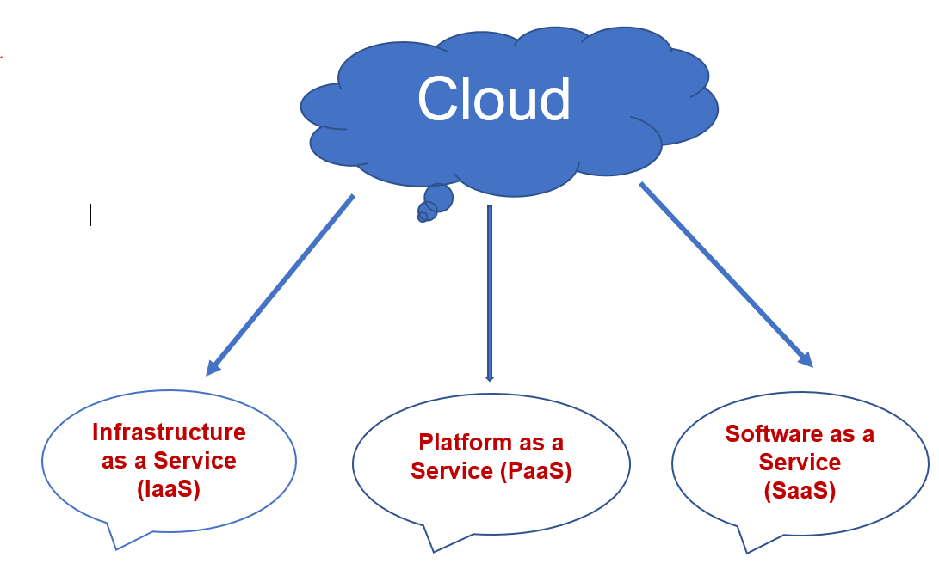
Cloud-Service Models
Following are the types of service models available in the cloud:

Slide 10
Cloud-Service Models
(1)Infrastructure-as-a-Service (IaaS)
IaaS provides access to fundamental resources such as physical machines, virtual machines, virtual storage, etc.
(2)Platform-as-a-Service (PaaS)
PaaS provides the runtime environment for applications, development and deployment tools, etc.
(3)Software-as-a-Service (SaaS)
SaaS model allows to use software applications as a service to end-users.

Slide 11
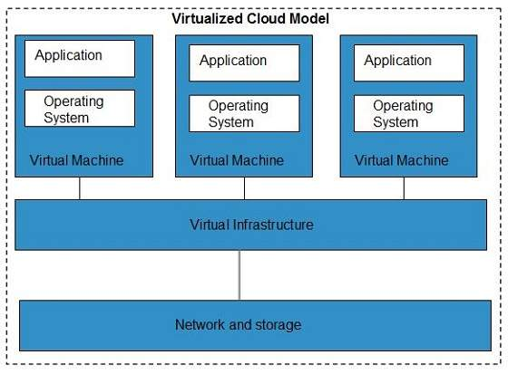
Virtualization
Virtualization is a technique, where a single physical instance of an application or resource is shared among multiple organizations or tenants (customers).
A logical name is assigned to a physical resource and a pointer is provided to that physical resource when demanded.
Once the physical server is divided, each logical server behaves like a physical server and can run an operating system and applications independently.

Slide 12
AWS-Introduction
AWS is a very secure cloud platform which offers computing power, Data storage, content delivery and other functionalities which help the business grow.
It is possible to host your database any where in the world and still you would be able to access them without any constraint.
There will not be much of cost difference but a little if you want to host in places like London as they need to abide by the special regulations which they need to necessarily abide.

Slide 13
Advantages
Flexibility
As you would not be knowing how much storage would be needed initially, if you enable autoscaling, storage would be adjusted accordingly.
Cost-effective
Pay-as –you –go model helps even small businesses to host as they don’t need to invest heavily when they begin.
Scalability
If you have a small unit to start with and if you are growing it is not a problem.
Security
Even real-time security is taken care. SSH keys play a vital role in providing the security of the data.

Slide 14
Domains of AWS
Compute: EC2(Elastic cloud compute) is responsible for letting you to have the resizable computing capacity. Lambda is again similar to EC2 but it cannot host websites.
Migration: Physically moving the data from one place to the data centre of your desired location.
Security and Compliance: Identity and Access Management system(IAM) and KMS(Key management system) takes care security.
Storage: Your storage place is called as bucket and whatever file you store in there is called as an object. For ex, CloudFront for content delivery and Glaciers for storing archives.

Slide 15
Domains used for Data analysis
Some of the domains that would be used for data analysis are DynamoDB and MongoDB which is a NoSQL database, S3 where you could store the exported data from the databases by creating buckets and the exporting of data will be happening through AWS Data pipeline.
After moving the data to S3 you would be able to save the information in the format of your choice.
For example, you can store the file as text file or you can store the file as Excel or CSV or whatever format you want.
Then you would be able to connect the database to Python and carry out the analysis.

